Slide 1
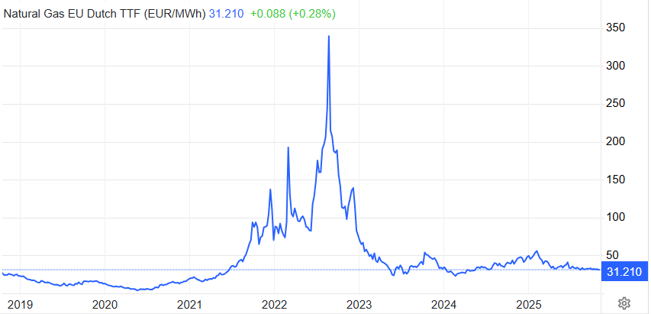
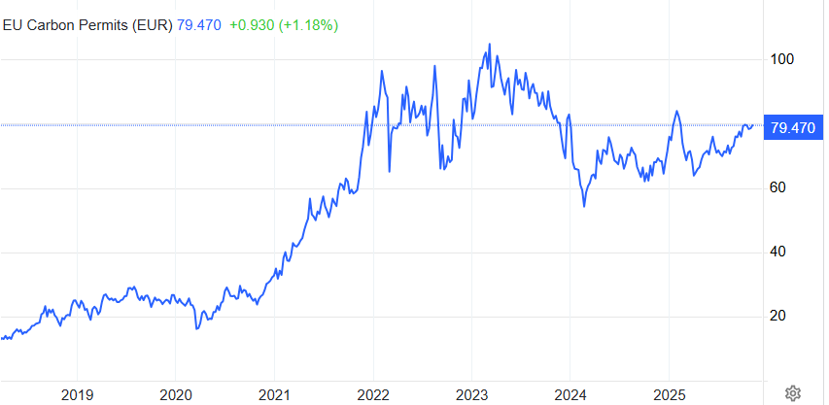
Daily Average Price
Important Context
Explosion of Gas Prices due to the Russian-Ukraine war
EU ETS Prices surged from 2021 and remain high due to stricter climate regulations, strong corporate demand, and tightening supply of certificates.

Slide 2
Electricity averaged around 40 €/MWh as gas and CO₂ prices were moderate and renewable output high.
Strong wind generation, especially in winter months, reduced reliance on fossil plants and therefore kept marginal costs down.
Negative prices appeared when wind generation exceeded demand during off-peak hours.
COVID-19 lockdowns slashed industrial demand across Europe, pushing prices down.
Gas and CO₂ prices dropped sharply due to reduced global energy consumption.
Increased renewable generation met lower demand, further suppressing prices.

Slide 3
Economic recovery after COVID-19 sharply increased electricity and gas demand.
Gas and CO₂ emission allowance prices surged, raising marginal generation costs.
2021 was a particularly weak year for wind output – forcing higher fossil generation, which further increased marginal generation costs.
The 2020-2021 winter was unusually cold across Europe, which drew down storage levels.
Furthermore Gazprom (Russia’s main exporter) sent less gas to Europe in 2021, both through spot markets and via long-term contracts. Some analysts saw this as pressure related to Nord Stream 2 certification delays.
Russia’s invasion of Ukraine triggered an unprecedented energy crisis. Gas supply cuts from Russia caused extreme price spikes and volatility across Europe.
Substitution with coal and oil increased marginal costs further due to expensive CO₂ certificates. (see Co2-Certificate Chart on Slide 1)
Governments introduced emergency market interventions and subsidies late in the year, partially stabilizing prices.

Slide 4
Prices began to decline as Europe adapted—filled gas storages, diversified LNG imports, and cut demand.
Strong wind and solar output lowered prices during renewable peaks.
Mild 2023-2024 winter reduced heating demand and eased pressure on supply.
Market normalization continued, but levels still remained higher than in 2019.
Europe still depends on gas-fired plants for marginal pricing, and gas prices have not returned to pre-crisis lows.
Higher carbon prices and ongoing geopolitical risks keep upward pressure on overall energy costs.
Grid congestion and renewable curtailment limit the full benefit of cheap renewable generation.

